Slide 1
Simple Interest and
Compound Interest

Slide 2
SIMPLE INTEREST:
If a person X borrows some money from another person Y for a certain period, then after that specified period, X (borrower) has to return the borrowed money with some additional money.
This additional money that X (borrower) has to pay is called Interest.
The actual borrowed money is called Principal or Sum.
The Principle and interest together is called amount, and the time for which X the borrower has been used the borrowed money is called the time.
The interest that X has to pay for every 100 rupees each year is called rate percent per annum.
If the interest on a sum borrowed for a certain period is reckoned uniformly, then it is called Simple Interest and it is denoted by S.I.

Slide 3
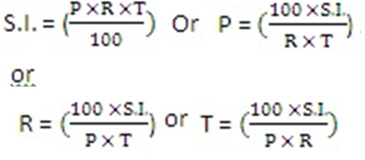
FORMULAE:
Let Principle = P, Rate =R% per annum, and Time = T years. Then,

Slide 4
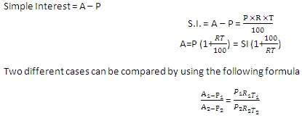
Now,
Simple Interest + Principle = Amount
If we denote the amount by ’A’, then

Slide 5
Practice Questions:
Q.1) The Simple Interest on a certain sum of money at 4% p.a. for 3 1/2 years is Rs.2800.The sum is
a)Rs.24000
b) Rs.20000
c) Rs.18000
d) Rs.16000

Slide 6
Q.2) The Simple interest on a sum of money at 4% p.a. for 2 years is Rs.3750. The sum is
a) Rs. 64875
b) Rs.46875
c) Rs.84675
d) Rs.48675

Slide 7
Q.3) How much time will it take for an amount of Rs. 450 to yield Rs. 81 as interest at 4.5% per annum of simple interest?
a) 3.5 yrs
b) 4 yrs
c) 4.5 yrs
d) 5 yrs

Slide 8
Q.4)A sum of money invested for a certain number of years at 8% p.a. simple interest grows to Rs.180. The same sum of money invested for the same number of years at 4% p.a. simple interest grows to Rs.120 only. For how many years was the sum invested?
a) 25
b) 15
c) 20
d) 22

Slide 9
Q.5) A man invested 1/5 th of his capital at 5% p.a , ¾ th of his capital at 12 % p.a. and the remaining at 20% p.a., all at SI. If his annual income from interest is Rs.660, then the amount invested by the man is ?
a)Rs.7500
b) Rs.10000
c) Rs.6000
d) Rs.9000

Slide 10
Q.6) Anurag borrowed a total sum of Rs. 8000 from two banks A and B. Bank A lends at 12 % p.a and bank B at 10% p.a., both at simple interest. After two years he paid a total interest of Rs.1816. What sum did anurag borrow from bank A?
a) Rs. 4400
b) Rs. 2600
c) Rs. 3600
d) Rs. 5400

Slide 11
Q.7) A sum of Rs. 800 amounts to Rs. 1040 in four years at simple interest. By how many percentage points should the rate of interest p.a be increased so that Rs.1200 would amount to Rs. 2400 in 8 years?
a) 4
b) 8
c) 5
d) None

Slide 12
Q.8) A certain sum 3 times itself in ten years under S.I. How many years it will take to become 9 times the principal?
a) 40
b) 50
c) 60
d) 70

Slide 13
Q.9) A sum of Rs.1200 amounts to Rs. 1800 in 10 years under S.I. What should be the rate of interest so that the same sum amounts to Rs.1800 in eight years under S.I?
a) 12.5 %
b)25%
c) 6.25%
d) 18 %

Slide 14
COMPOUND INTEREST:
When the borrower X and the lender Y agrees to fix up a certain time for example yearly, half yearly or quarterly to settle the previous money, then the difference between the amount and the money borrowed is said to be the Compound Interest and it denoted by C.I.
In these calculations, principal for the second unit of time is the amount of first unit of time and so on.

Slide 15
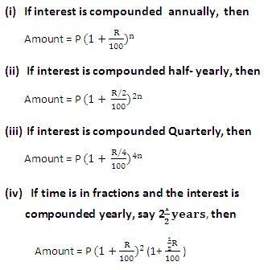
FORMULAE:
Let Principal = P, Time = n years

Slide 16
Difference between Compound Interest & Simple interest Concept :
For Two years:
CI – SI =P(r/100)²
For Three Year:
CI – SI =P(r²/(100² ))×(300+r)/100)

Slide 17

CALCULATION OF COMPOUND INTEREST USING PASCAL’S TRIANGLE
Concept of Pascal’ triangle
The Pascal’s triangle is a representation of numbers in the form of a triangle as follows

Slide 18
Each number in this triangle is obtained by adding the two numbers immediately above it.
For eg) Number 2 in the second line is obtained by adding the two 1s above it. Similarly the “6” in the fourth line is obtained by adding the two 3’s above it
This pattern of numbers has a unique application in the calculation of Compound Interest, and it simplifies the calculation tremendously.
Let’s take the following example to calculate the Compound Interest using Pascal’s triangle

Slide 19
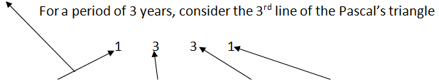
Example:
What is the Amount obtained on a principal amount of 8000 rupees with a rate of 5% for a period of 3 years compounded annually?
Solution:
Principal = 8000 Rate= 5%
Amount is =8000(1) + (5% of 8000=400)(3) + (5% of 400=20)(3) + (5% of 20 =1)(1)
Answer= 8000 + 1200 + 60 + 1 =9261
If we need to only find the interest, subtract the principal from the amount 9261- 8000 = 1261

Slide 20
PRACTICE QUESTIONS:
Q.1) How much will Rs.7500 amount to in two years at the rate of 12% p.a. compound interest?
a) Rs.8904
b) Rs.9048
c) Rs.9408
d) Rs.9804

Slide 21
Q.2) A sum of money quadruples at a certain rate of compound interest in six years. In how many years will it become sixteen times itself?
a)10
b)12
c)18
d)24

Slide 22
Q.3) Find the CI on a sum of Rs.6000 at 16% p.a. for 9 months when interest is compounded quarterly (approx)?
a) Rs.762.80
b) Rs.854.10
c) Rs.749.20
d) Rs.924.10

Slide 23
Q.4) The value of a car depreciates at the rate of 12% p.a. every year. If the present value of the car is Rs.154880. its value two years ago was ?
a) Rs.360000
b) Rs.240000
c) Rs.200000
d) Rs.300000

Slide 24
Q.5) The compound interest on a sum of money for 2 years is rs.832 and the simple interest on the same sum for the same period is rs.800 .the difference between the compound interest and simple interest for 3 years is
a) 48
b) 66.56
c) 98.56
d) None

Slide 25
Q.6) A sum of rupees 10000 becomes 14400 compounded annually with rate of interest 20%. Find the number of years?
a) 1 yrs
b) 2 yrs
c) 3 yrs
d) 4 yrs

Slide 26
Q.7) The difference between compound interest and simple interest on a sum for 2 years at 10% per annum, when the interest in compounded annually is Rs.16. If the interest were compounded half yearly, the difference in two interests will be
a) Rs.24.81
b) Rs.31.61
c) Rs.32.40
d) Rs.36.90

Slide 27
Q.8) A sum is being lent at 20% p.a. compound interest. What is the ratio of increase in amount of 4th year to 5th year?
a) 4 : 5
b) 5 : 4
c) 5 : 6
d) Cannot be determined

Slide 28
Q.9) The compound interest and the simple interest for two years on a certain sum of money at a certain rate of interest are Rs. 2257.58, Rs. 2100 respectively. Find the principal and rate percent:
a) 6000, 7%
b) 7500, 8%
c) 14000, 10%
d) 7000, 15%

Slide 29
Q.10) The ratio of the amount for two years under CI annually and for one year under SI is 6 :5. When the rate of interest is same, then the value of rate of interest is:
a) 12.5%
b) 18%
c) 20%
d) 16.66%

Slide 31


